Slide 1

Targeted HFA Spot Checks
Country report: Malawi
May - June 2024
Date: August 1, 2024
Disclaimer: “The opinions expressed in this presentation and on the following slides are solely those of the presenter and not necessarily those of IQVIA. IQVIA does not guarantee the accuracy or reliability of the information provided herein.”

Slide 2
Introduction
Objectives of Spot-checks & tHFA
Process - Steps involved & where we are now…
Technical details – We went to Sampled facilities, (# of HFs) with select, tracers list (# of tracers), & also at central level and following 5 indicators assessed for performance
Why – Shift in TGF strategy to focus on IPCQS, community health. Collecting performance framework metrics to monitor progress

Slide 3
Key tHFA sections with KPI and Non-KPI with broader message
The objective of t-HFA is to assess the impact of GF’s investments on the readiness of the health facilities to provide and deliver quality HIV, TB and Malaria care the t-HFA measures the following 10 quantitative KPIs:
Provision of integrated, people-centered, high-quality services
Provision of integrated supportive supervision
HTM integrated services offered to pregnant women
Systems readiness for community health workers
Percentage of facilities providing effective services. Composite facility level indicator with 7 components
Percentage of community health workers remunerated on time and in-full (as per their contract) every month during the reporting period
Percentage of health service delivery sites with a community-led monitoring mechanism in place
Percentage of facilities with written and updated clinical guidelines for HIV, TB, malaria and/or PHC (based on the services provided) developed by the national or sub-national government (as appropriate by the country context)
Percentage of health facilities able to provide oxygen therapy related services among those providing the service
Percentage of health facilities that have an appropriate set of diagnostics for their healthcare facility level, based on adapted WHO model list of essential in vitro diagnostics
Vacancy score

Slide 4



Table of Contents
1. Executive Summary
2. Methodology
3. Key Findings
and Insights
Provides a description of the sampling, data quality assurance and the analysis approach, as well as challenges encountered in methodology, if any.
Summarizes the scope, key findings and highlights for the country.
Reflects the key findings and highlights.

Slide 5


1. Executive Summary
2. Methodology
3. Key Findings
and Insights
Provides a description of the sampling, data quality assurance and the analysis approach, as well as challenges encountered in methodology, if any.
Summarizes the scope, key findings and highlights for the country.
Reflects the key findings and highlights.

Slide 6
Executive Summary
Service delivery numbers
# of places visited (primary, sec, ter) & urban rual etc
Areas avoided because of insecurity in any
Indicators at country level

Slide 7

1. Executive Summary
3. Key Findings
and Insights
2. Methodology
Provides a description of the sampling, data quality assurance and the analysis approach, as well as challenges encountered in methodology, if any.
Summarizes the scope, key findings and highlights for the quarter.
Reflects the key findings and highlights.

Slide 8
tHFA Sampling: 120 health facilities in each country
30% of facilities sampled purposively with focus on Global Fund-supported facilities. Remaining (70%) selected using stratified random sampling.
Master Facility List
120 facilities
36 facilities
(12 per domain)
84 facilities
(28 per domain)
Primary
Secondary
Tertiary
30% of the facilities will be purposively sampled (and revisited over subsequent surveys as a panel).
These will be primarily the tertiary and secondary facilities expected to receive Global Fund support.
70% of the facilities will be selected using stratified random sampling.
All public facilities will be categorized as primary, secondary or tertiary.
Within each strata, we will select facilities based on the following proportion: 34% primary facilities, 43% secondary facilities and 23% tertiary facilities.
8

Slide 9



Before data collection, several activities planned to ensure data quality during data collection
Activities including translation of questionnaire, pre-pilot, recruitment of qualified enumerators, rigorous trainings planned before data collection
Translations of the questionnaire in local languages
Testing the questionnaire on the digital platform (e.g. Survey CTO)
Pre-pilot to be conducted in 2-4 facilities to test the questionnaire on field
Provide feedback to Global Fund team based on pre-pilot to refine questionnaire
Questionnaire testing
Enumerator recruitment guidelines agreed with Global Fund will be followed (slide 4)
SPs will share the final roster of enumerators with qualifications and experience details of the survey team
Clear directions on team member roles and responsibilities
Recruitment
Training of the enumerators supported with survey manual, field protocol manual and training material
Pre- and post-training test for survey team, results shared with TGF
Conduct dummy interviews and role plays on the use of data tool
Field training and false start with survey teams to ensure training and direction provided by TGF team are followed.
Training

Slide 10




In-field checks by SPs on Data Quality for Spot Check Round 4 and t-HFA Baseline
Stronger quality checks including spot-checks, back-checks and telephonic confirmations to be implemented
Telephone confirmations
50% telephone confirmations will done by SPs
SPs will document and provide regular updates on the status of confirmations
For facilities where status reveals no interview conducted, enumerator responsible will be removed from the data collection team
Spot checks
5% spot checks/accompaniment will be carried out by SPs where the supervisors will go to 5% randomly selected facilities with the enumerators to check data quality
SPs will document and provide regular updates on the spot checks
Based on the spot checks, the enumerators that need further training will be identified to provider refresher training, if required
Back-checks
10% back-checks will done by SPs where supervisors will go to 10% facilities with a brief questionnaire to collect data Internal team will provide a common back-checks questionnaire for SPs to follow
Back-checks will be done using tablet assisted interviewing software to ensure consistency
SPs will compare back-checks data with main data and check for inconsistencies
GPS checks
GPS data will be captured and validated based on the facility location
Enumerators consistently found to be away from the facility location will be questioned and monitored closely

Slide 11
Methodology: Data Analysis approach
Adapt using annex 1 shared

Slide 12
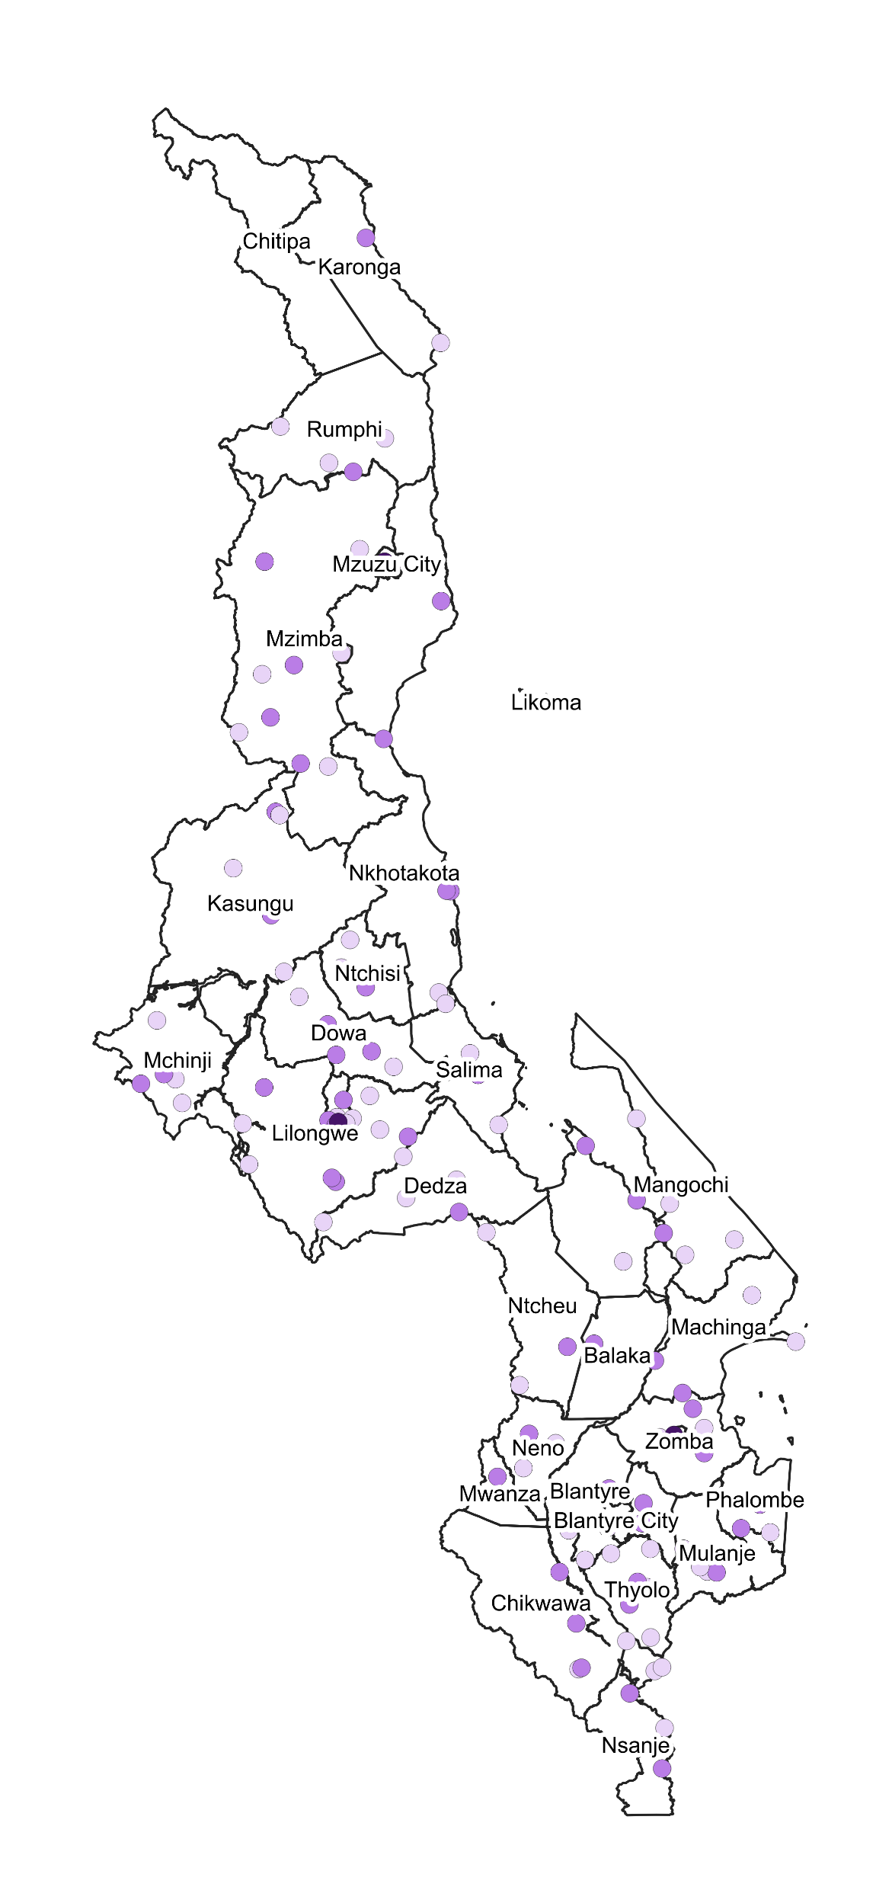



Facility demographics and service availability mapping
Supply Chain and Health Services Dashboard
Map of Malawi showing geographical spread of visited facilities
Distribution of services provided by location and facility type, %
Facility location
HIV
TB
Malaria
ANC
Immu.
Health care facilities in
rural areas
N/A
N = 84
Health care facilities in
peri-urban areas
N = 13
Health care facilities in
urban areas
N = 23
Facility type
HIV
TB
Malaria
ANC
Immu.
Primary health care
facilities
N = 63
Secondary health care facilities
N = 53
Tertiary health care
facilities
N = 4

Slide 13
1. Executive Summary
3. Key Findings
and Insights
2. Methodology
Provides a description of the sampling, data quality assurance and the analysis approach, as well as challenges encountered in methodology, if any.
Summarizes the scope key findings and highlights for the quarter.
Reflects the key findings and highlights.

Slide 14
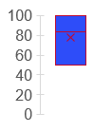
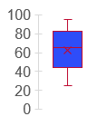
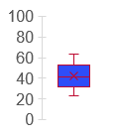
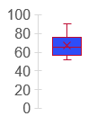
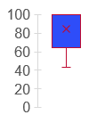
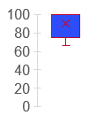
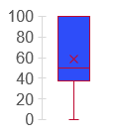
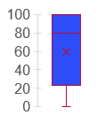
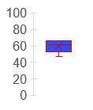
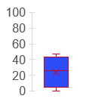
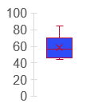
Country level scores for the 11 tHFA indicators
Supply Chain and Health Services Dashboard
High Quality Services
Integrated Supp. Supervision
Integrated HTM for ANC patients
System Readiness for CHWs
58
87
63
60
Facility Composite Score
CHW paid on time and in full
Community Led Monitoring
Availability of Guidelines
70
57
79
88
Oxygen Therapy
Appropriate Testing
Vacancy Score
High facility averages for guidelines, supportive supervision, availability of O2 and community led monitoring
Average means for xx, yy, zzz however these had a wide spread with highs of 90 an lows of 20 and below observed
Appropriate Testing
64
51
30

Slide 15
Country level scores for the 11 tHFA indicators
Average of 11 indicators for each facility type (Percent %)
High facility averages for guidelines, supportive supervision, availability of O2 and community led monitoring
Average means for xx, yy, zzz however these had a wide spread with highs of 90 an lows of 20 and below observed
Xxxx

Slide 16
KPI 1 : Provision of integrated, people-centered, high-quality services
Unfinished
Supply Chain and Health Services Dashboard
Country Average for Indicator and Primary Dimensions
Average by facility types
Primary health care
facilities
58
Secondary health care facilities
Tertiary health care
facilities
67
50
Add chart to show all indicator scores on this page
Patient-centeredness
Health worker competence

Slide 17
KPI S2: Provision of integrated supportive supervision
Unfinished
Supply Chain and Health Services Dashboard
Country Average for Indicator and Primary Dimensions
Average by facility types
Primary health care
facilities
58
Secondary health care facilities
Tertiary health care
facilities
Add chart to show all indicator scores on this page

Slide 18
KPI S3: HTM integrated services offered to pregnant women
Unfinished
Supply Chain and Health Services Dashboard
Country average for indicator and dimensions for Integrated HTM during ANC visits
Average for indicator and dimensions for Integrated HTM during ANC visits by facility types
Primary health care
facilities
58
Secondary health care facilities
Tertiary health care
facilities
Add chart to show all indicator scores on this page

Slide 19
RSSH/PP HRH-6: Percentage of facilities providing effective services
Supply Chain and Health Services Dashboard
Country average for indicator and dimensions for the 7-component facility composite score
Average for indicator and dimensions for the 7-component facility composite score by facility levels
Primary health care
facilities
70
Secondary health care facilities
Tertiary health care
facilities
The facility composite score was relatively high in Malawi with a country average of 70. ANC dropout rate was the attribute with the worst performance with DPT dropout being the highest attribute. This indicates the strength of the immunization program and the potential weakness of ante-natal care especially at primary levels
Country averages were relatively similar between the different service levels. However, there are notable differences between the different levels for patient caseloads, ANC dropout, DPT dropout, and ART retention

Slide 20
RSSH/PP HRH-3: Percentage of community health workers remunerated on time and in-full every month during the reporting period
Unfinished
Supply Chain and Health Services Dashboard
Country average for indicator for CHW renumeration on time & in full
Average for indicator for CHW renumeration on time by facility levels and setting of facility
Primary health care
facilities
70
Secondary health care facilities
Tertiary health care
facilities
Xxxxxxxx
Xxxxxx

Slide 21
CSS-3: Percentage of health service delivery sites with a community-led monitoring mechanism in place
Unfinished
Supply Chain and Health Services Dashboard
Country average for indicator for community-led monitoring in place
Average for indicator for community-led monitoring in place by facility levels and setting of facility
Primary health care
facilities
70
Secondary health care facilities
Tertiary health care
facilities
Xxxxxxxx
Xxxxxx

Slide 22
HSG-1.1: Percentage of facilities with written and updated clinical guidelines for HIV, TB, malaria and/or PHC developed by the government
Unfinished
Supply Chain and Health Services Dashboard
Country average for indicator and dimensions for the 7-component facility composite score
Average for indicator and dimensions for the 7-component facility composite score by facility levels
Primary health care
facilities
70
Secondary health care facilities
Tertiary health care
facilities
The facility composite score was relatively high in Malawi with a country average of 70. ANC dropout rate was the attribute with the worst performance with DPT dropout being the highest attribute. This indicates the strength of the immunization program and the potential weakness of ante-natal care especially at primary levels
Country averages were relatively similar between the different service levels. However, there are notable differences between the different levels for patient caseloads, ANC dropout, DPT dropout, and ART retention

Slide 23
Summary of findings and recommendations
Unfinished
Summary findings
Challenges
Recommendations
Service availability
There was availability of HIV, TB, Malaria and COVID-19 services at facilities of different levels
All facilities provided malaria diagnostics and treatment services
Nil
Continue to support and strengthen facilities to provide TB, Malaria, and HIV services especially in hard-to-reach areas
Update the Master Facility List periodically to reflect the realities of service provision across the country
On-Shelf Availability
Tracer products were generally available in most facilities visited
Gaps still exist in the availability of some key products especially TB diagnostics products & malaria diagnostics in primary and secondary health facilities
Conduct a root-cause analysis for the stock-outs of TB diagnostics products across the facilities as there was a reported over-stock in all the medical stores visited
On Time In Full
There was a huge gap in the delivery of products especially for TB diagnostics
Lateness of deliveries was a large inhibitor to supply chain effectiveness and availability of commodities on shelf
Review delivery routes to account for challenges and unexpected delays especially in remote and hard-to-reach regions
Stock According To Plan
There was availability of most tracer products at the different medical stores visited
None of the tracer products was stocked in adequate levels with many products being overstocked at the different stores
Strengthen the data management practices at the medical stores and develop processes to use the data to adjust stock levels as required
LMIS
LMIS reporting was varied across the facilities levels with tertiary facilities reporting the most
LMIS composite scores were relatively high for disease areas apart from COVID-19.
Reporting rates are still relatively low in primary and secondary facilities
Gaps still remain in the accuracy of the reports
Conduct of LMIS verification should be prioritised during supportive supervision visits especially to primary and tertiary health facilities
We will work with relevant stakeholders and logistics working group to develop a detailed implementation plan to address gaps identified from the spot check

Slide 24
Thank you

